Slide 1
Improve Number of Reviews for Airbnb Hosts
By Kit Hui

Slide 2
Proposal Statement
Use number of reviews can be used as an inferential metric to the number of consumers that have lodged at Airbnb home
Airbnb hosts can improve lodging rates and more income
Hosts have a guideline to improve hosting experience
More satisfied consumers and better consumer return rate for Airbnb
Approach:
Data Wrangling
Explore the data
Machine learning

Slide 3
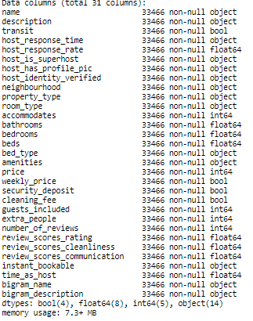
Data
Data collected from http://insideairbnb.com/get-the-data.html for Los Angeles Airbnb homes
Cleaning: dropped unimportant features like ID, listing_url, etc. Drop extreme bias like high number of bedroom
Feature engineering:
Create time_as_host
Transit, cleaning fee and weekly price to binary
Fill null values from ratings to 0
NLP on name and description feature:
Only English text
Lowercase all text
Tokenize to words
Lemmatize
Remove all stop works and numbers
2-gram feature

Slide 4
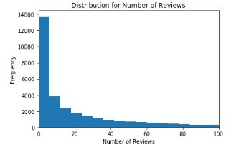
Distribution of Number of Reviews
50% of Airbnb homes have less than 10 reviews
Top 25% receives more than 42 reviews
17% have 0 reviews

Slide 5
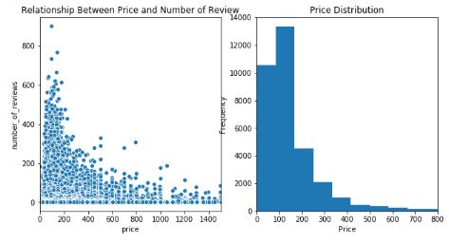
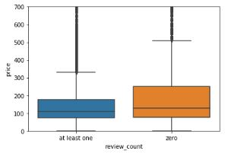
Number of review and Price
75% of at Airbnb homes with at least one review cost less than $350 whereas that of Airbnb homes with 0 review cost more than $500.
Median is approximately the same.
Homes that receives the most reviews are contained between $25 and $200
Hypothesis permutation testing shows statistical difference between number of reviews in the upper price range and the lower price range

Slide 6
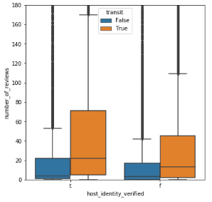
Transit and host verification on Number of Review
Number of reviews for those that provide transit information is 4-8 times higher than those that did not
Host identity plays an impacting role for the top 50% Airbnb homes

Slide 7
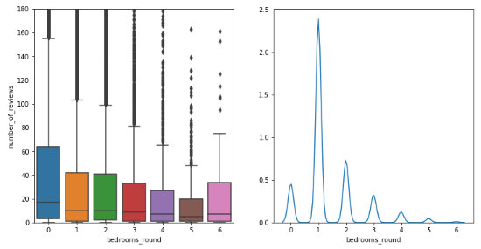
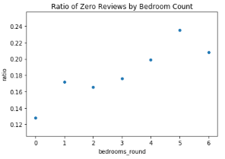
Bedrooms
Ratio of zero reviews increases linearly as bedroom count increases
Median number of reviews decreases as bedroom count increases

Slide 8
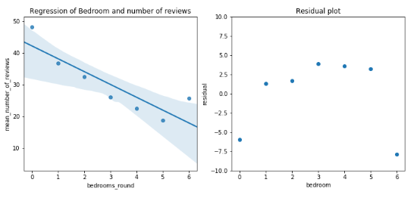

Bedrooms cont.
Mean number of reviews vs bedroom count. Exhibit approximate linear relationship
P-value shows statistical significance of the model
The sixth bedroom may be an outlier

Slide 9
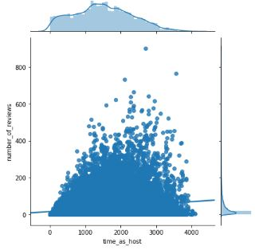
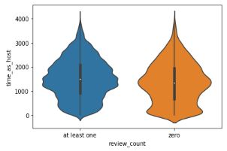
Time as Host and Review Counts
Observed phases in the zero review counts plot
The middle peak may correspond to high supply
Peak closer to 0 results from very limited consumers early on after signing up for the platform
Higher numbers of reviews at the higher end

Slide 10
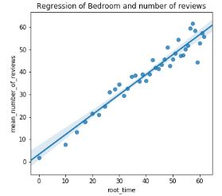
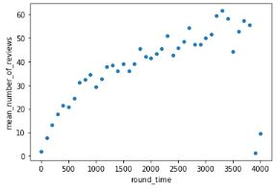

Time as Host and Review Count cont.
Square root time
Remove outlier
Mean number of review and time as host
A small suggestion of saturation of number of reviews

Slide 11
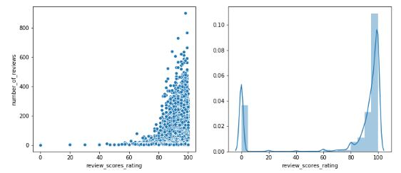
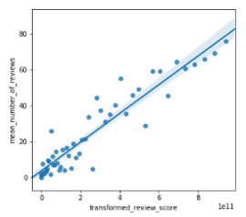
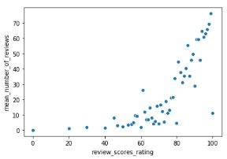

Rating and Number of Review
High frequency of 0 is result of earlier fillna for null. Good assumption because average of 0 review is 0 number of reviews
Over 50% of Airbnb homes have rating above 95 pt
Reviews appears to improve exponentially as rating increase
After transformation, linear regression model shows statistically significant p-value
x⁶
Drop outlier

Slide 12
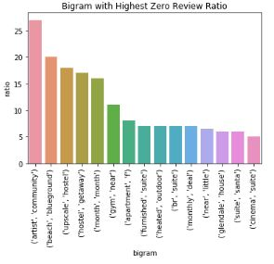
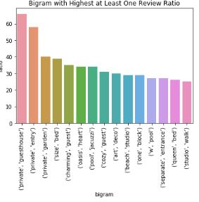
Bigram and review counts
Common theme Airbnb home that gets zero reviews is hostel or suite and suggesting time
For at least one reviews, words of comfort and privacy
Note: the bar graphs resulted by sorting and measuring the ratio of zero reviews to total review eliminating common bigrams

Slide 13
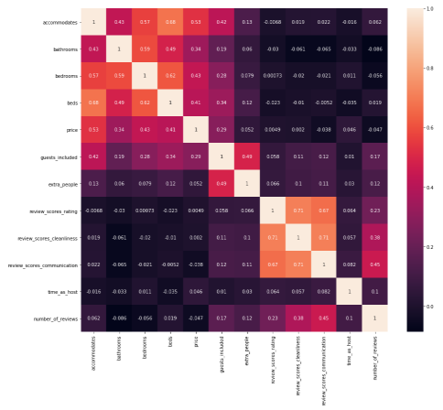
Machine Learning
Remove features with strong correlations
PCA was not conducted because of memory constraint
Numerical pipeline-standard scaling
Categorical pipeline-onehot encoding, variance threshold
Text pipeline:
1. Bag of Words
2. Tfid
3-fold Cross validation

Slide 14
Machine Learning
Model | Train R² | Test R² | Mean Square Error | Mean Absolute Error | Max Error
Ridge Regression (bag of words) | 0.41 | .32 | 2495 | 29 | 777
Ridge Regression (Tfid) | 0.43 | 0.32 | 2480 | 29 | 780
Random Forest | 0.77 | 0.41 | 2193 | 23.5 | 784
XG Boosting | 0.63 | 0.42 | 2164 | 25 | 760
DNN-LSTM | 0.52 | 0.41 | 2207 | 25 | 708
Mean square error, mean absolute error and max error was obtained after processing the predicted target values by flooring negative values to 0
Random forest appears be most fitting for our objective with lowest mean absolute error and comparable R² to others high performing models

Slide 15
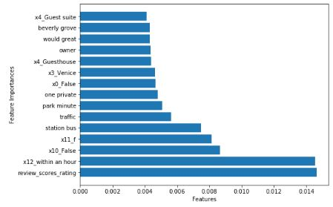
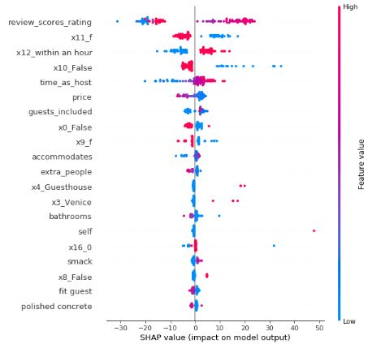
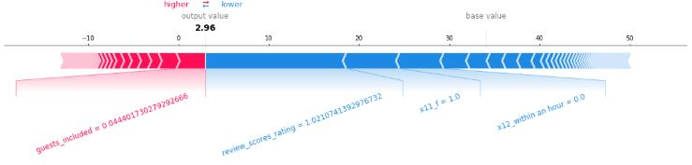
Interpreting the Model (XG boosting)
Notes:
Feature importance global observation of how features affect model outcome
Shap local observation
All showing review score rating and responding within an hour plays a huge role in review counts

Slide 16
Future work
Data transformation on other features
With larger memory, PCA
Pictorial data to further improve learning
Combine the LA data with other locations
Other types of ensemble learning like stacking
Bag of words for deep learning instead of DNN-LSTM
Notes:
Feature importance global observation of how features affect model outcome
Shap local observation
All showing review score rating and responding within an hour plays a huge role in review counts

